Slide 1
Software Design and Architecture
Lecture-11
Behavioral GoF Patterns
Observer Pattern,
Mediator Pattern

Slide 2
GoF Behavioral Patterns
These patterns are concerned with the algorithm and assignments of responsibilities between objects.
Define the communication between objects, control flow, interconnection between objects.

Slide 3
GoF Behavioral Patterns
  Strategy
  Observer
  Interpreter
  Command
  Chain of responsibility
  Iterator
  Mediator
  Memento
  State
  Template Method
  Visitor

Slide 4
The Observer Pattern

Slide 5
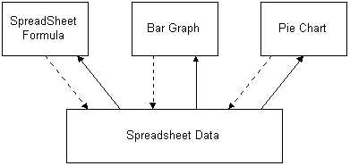
Example
In a spreadsheet program, the Observer pattern can be applied as in the following diagram. Each rectangular box in the diagram is an object that observes. SpreadSheetFormula, BarGraph, and PieChart are the observer objects. SpreadsheetData is the subject object. The SpreadsheetData object notifies its observers whenever a data changes that could make it's state inconsistent with the observers.

Slide 6
Example
Lets think of an example where a head hunter is responsible of notifying all the registered developers of any job opening that comes his way.

Slide 7
Example (contd)
What would the requirements be of such a scenario??
  All the developers in the list should be notified of the job opening.
  Whenever there is some update from the head hunter, the notification should be sent to all the contacts in the list.
  The head hunter should send notification to all the developers without knowing who they are.
  Any number of developers can subscribe to the head hunter’s list.

Slide 8
The Observer Pattern
The Observer pattern assumes that:
  the object containing the data is separate from the objects that display the data
  these display objects observe changes in that data.
When we implement the Observer pattern, we usually refer to the data as the Subject and each of the displays as Observers.
Separates the display of object state from the object itself.
Used when multiple displays of state are needed.

Slide 9
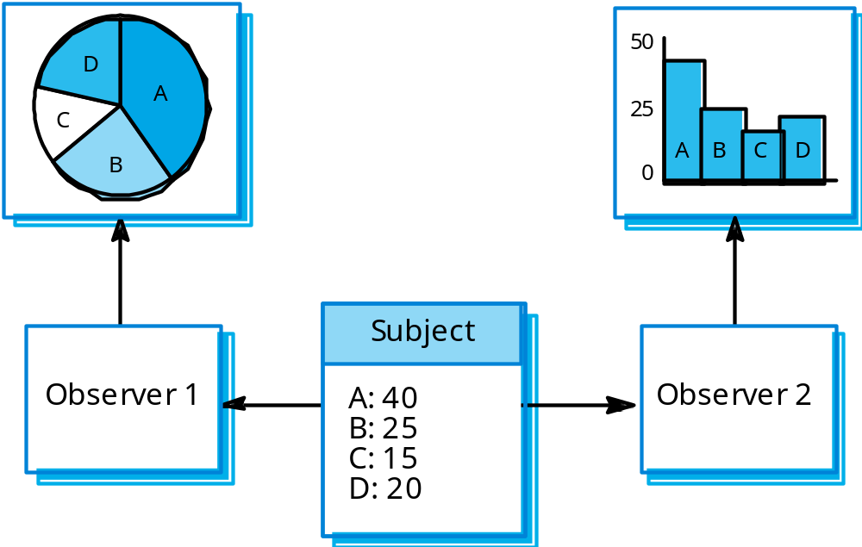
Example
Both a spreadsheet object and bar chart object can depict information in the same application data object using different presentations.

Slide 10
Example
The spreadsheet and bar chart are dependent on the data object
  therefore any change in its state should be notified.
  When the user changes the information in the spreadsheet, the bar chart reflects the changes immediately, and vice versa.
b
a
b
c
x
60
30
10
a
c
y
50
30
20
z
80
10
10
a b c
a = 50%
b = 30%
c = 20%
requests, modifications
change notification

Slide 11
Intent
Define a one-to-many dependency between objects
  when one object changes state, all its dependents are notified and updated automatically.

Slide 12
Application
The key objects in this pattern are subject and observer.
  A subject may have any number of dependent observers.
    All observers are notified whenever the subject undergoes a change in state.
    In response, each observer will query the subject to synchronize its state with the subject's state.

Slide 13
How it Works?
Each of the observers registers its interest in the data by calling a public method in the Subject.
Then, each observer has a known interface that the subject calls when the data change.

Slide 14
When to use Observer pattern?
Use the Observer pattern in any of the following situations:
  When an abstraction has two aspects, one dependent on the other. Encapsulating these aspects in separate objects lets you vary and reuse them independently.
  When a change to one object requires changing others, and you don't know how many objects need to be changed.

Slide 15
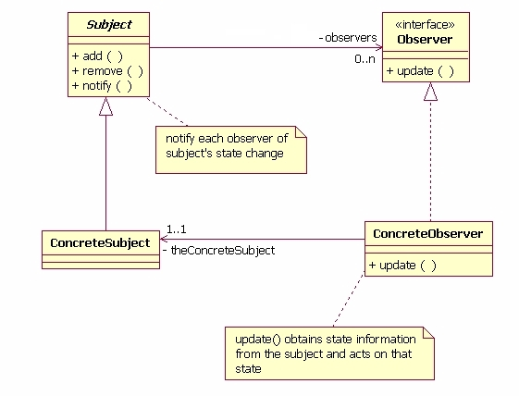
Structure / Graphical Notation

Slide 16
Participants
Subject:
  Knows its observers.
  Provides an interface for attaching and detaching observer objects.
  Sends a notification to its observers when its state changes by invoking their update method.
Observer:
  Defines an updating interface for concrete observers.
Concrete Subject:
  Stores state of interest to concrete observers.
Concrete Observer:
  Maintains a reference to a concrete subject object.
  Stores state that should stay consistent with the subject's state.
  Implements the updating interface

Slide 17
Implementation
We need to define the following:
  Observer Interface
  Concrete Observer classes
  Subject class
  Concrete Subject class
  Client class

Slide 18
Observer Interface
// IObserver --> interface for the observer
public interface IObserver
{
// called by the subject to update the observer of any change
// The method parameters can be modified to fit certain criteria
void Update(String message);
}

Slide 19
Subject Abstract Class
public abstract class Subject
{
// use array list implementation for collection of observers
private ArrayList observers;
// constructor
public Subject();
public void add(IObserver observer);
public void remove(IObserver observer);
public void Notify(IObserver observer);
}

Slide 20
Concrete Subject
public class ConcreteSubject extends Subject
{
private ArrayList observers;
public Subject()
{
observers = new ArrayList();
}
public void add(IObserver observer)
{ // if list does not contain observer, add
if(!observers.Contains(observer))
{
observers.Add(observer); //ArrayList built in method
}
}

Slide 21
Concrete Subject (Contd…)
public void remove(IObserver observer)
{ // if observer is in the list, remove
if(observers.Contains(observer))
{
    observers.Remove(observer); //ArrayList built in method
    }
}
public void Notify(string message)
{ // call update method for every observer
foreach(IObserver x in observers)
{
x.Update(message); // Observer class method
}
}

Slide 22
Concrete Observer-1
// Observer1 --> Implements the IObserver
public class Observer1 implements IObserver
{
public void Update(string message)
{ Console.WriteLine("Observer1:"+message);
}
}

Slide 23
Concrete Observer-2
// Observer1 --> Implements the IObserver
public class Observer2 implements IObserver
{
public void Update(string message)
{ Console.WriteLine("Observer2:"+message);
}
}

Slide 24
Client Class
public class ObserverTester
{
public static void Main()
{
ConcreteSubject mySubject = new ConcreteSubject();
IObserver ob1 = new Observer1();
IObserver ob2 = new Observer2();
// add the observers
mySubject.add(ob1);
mySubject.add(ob2);
mySubject.Notify("message 1");
mySubject.Notify("message 2");
}
}

Slide 25
Benefits
It lets you add or remove observers without modifying the subject or other observers.
All a subject knows is that it has a list of observers, each conforming to the simple interface of the abstract Observer class. The subject doesn't know the concrete class of any observer. Thus the coupling between subjects and observers is abstract and minimal.
Unlike an ordinary request, the notification that a subject sends needn't specify its receiver. The notification is broadcast automatically to all interested objects that subscribed to it. It's up to the observer to handle or ignore a notification.

Slide 26
Drawbacks
Subject can be reused only with the Observer abstraction. This reduces the reusability of the Subject in a totally different context.
Subject should maintain a list of Observers. In some cases, the Observers may request only for specific events for which the Subject has to notify them. Subject should also maintain this information along with the list of Observers, which increases the overhead.

Slide 27
Suggested Reading
Chapter 5, page 293-304.
  Design Patterns: Elements of Reusable Object-Oriented Software.

Slide 28
The Mediator Pattern

Slide 29

Mediator Pattern – Example Applications
A very common example can be airplanes interacting with the control tower and not among themselves. The control tower knows exactly, where each of the airplanes is, and guides them whereas the airplanes have their own responsibilities of landing and takeoff.

Slide 30
Mediator Pattern – Example Applications
Another popular example is Stock exchange. In old days when there were no stock markets, the individual brokers used to buy or sell commodities among themselves. They used to face huge risks, of defaulting of counterparty, limited information (as, only limited deals in limited areas were possible), price variance (everyone could quote whatever price they wanted) and many more.

Slide 31
Problem Statement
The mediator pattern deals with the complexity which comes in the coding when number of classes increase. While beginning with development, there are a few classes and these classes interact with each other producing results. Gradually, the logic might become more complex and functionality might increase. More classes are added and they still interact with each other but it gets really difficult to maintain this code now.

Slide 32
Solution – The Mediator Pattern
  Mediator pattern takes care of this problem. It makes the code more maintainable. It promotes loose-coupling of classes such that only one class (Mediator) has the knowledge of all the classes, rest of the classes have their responsibilities and they only interact with the Mediator.

Slide 33
The Mediator Pattern
Intent:
  Define an object that encapsulates how a set of objects interact. Mediator promotes loose coupling by keeping objects from referring to each other explicitly, and it lets you vary their interaction independently.
  Design an intermediary object to decouple many peers.

Slide 34
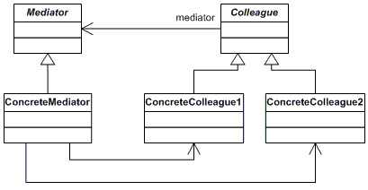
The Mediator Pattern
Structure:
Colleagues (or peers) are not coupled to one another. Each talks to the Mediator, which in turn knows and conducts the orchestration of the others.

Slide 35
The Mediator Pattern
Implementation:
  Mediator keeps a reference of its Colleagues
  Colleague sends a message to the mediator, Mediator checks to which colleague is the message actually directed to and sends it to that colleague

Slide 36
The Mediator Pattern
Participants:
  The classes and/or objects participating in this pattern are:
  Mediator
    defines an interface for communicating with Colleague objects
  ConcreteMediator
    implements cooperative behavior by coordinating Colleague objects
    knows and maintains its colleagues
  Colleague classes
    each Colleague class knows its Mediator object
    each colleague communicates with its mediator whenever it would have otherwise communicated with another colleague.

Slide 37
Benefits
Decouples colleagues
  This facilitates independent variations of the colleagues and the mediators which further facilitates reusability.
Simplifies Protocols
  By replacing many-to-many interactions with one-to-many interaction, object relationships become easier to understand.
Abstracts Object’s Behavior and Interaction:
  This allows one to deal with an object’s small scale behavior separately from its interaction with its interaction with other objects.

Slide 38
Disadvantages
Reducing complexity of colleagues increases the complexity of the mediator itself. In some situations, maintaining a large mediator might become a daunting task.

